Slide 1
Rotational Motion
Circle movement

Slide 2
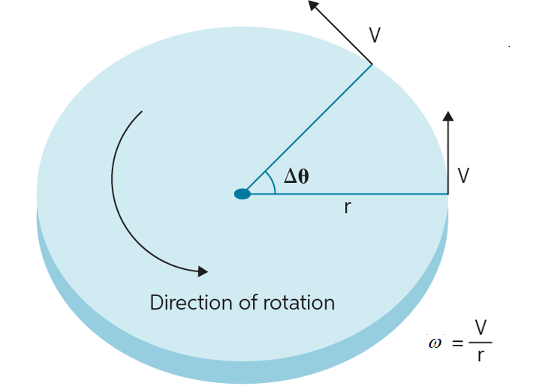
Rotating Objects?
Wheel
Disk
Sphere
Lots of things can rotate!

Slide 3
Variables
Angular displacement (θ): Change in Angle
Angular velocity (ω): Change in angle of time
Angular acceleration (α): Change of angular velocity over time
Radius (r): How far away something is
Moment of Inertia (I): like mass but for rotating objects

Slide 4
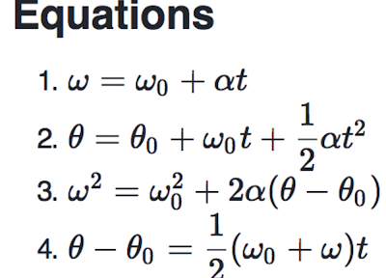
These are Awfully Similar to Kinematics...
Everything has a linear equivalent!
Kinematic equations still apply
A horizontally mounted wheel is initially at rest, and then begins to accelerate constantly until it has reached an angular velocity 10 pi after 5 complete revolutions. What was the angular acceleration of the wheel?
Notes:
2 pi Use time not known or eq 4

Slide 5


More Kinematic and Rotational Connections
r*Δθ=Δx
r*ω=v
r*α=a
Units?
Radians!
What is the acceleration of a point a distance of 3m away from the rotational point and an angular acceleration of 3 rad/s²?

Slide 6
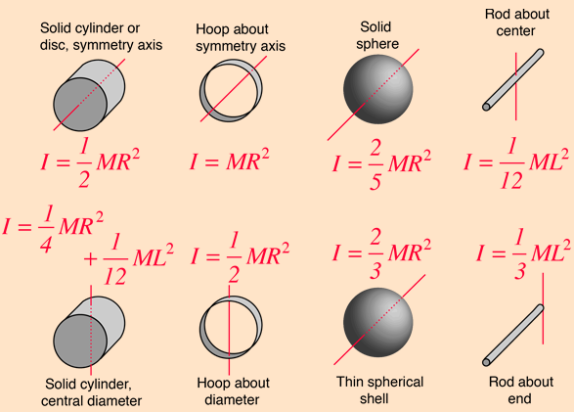
Moment of Inertia
Rotational Mass
Equations depend on shape
Why it is harder to rotate an unfilled hoop
https://www.youtube.com/watch?v=CHQOctEvtTY
Units?
Notes:
https://www.youtube.com/watch?v=CHQOctEvtTY

Slide 7
Practice Question
What is the moment of inertia of a sphere with mass 6kg and radius 5m?
What about a solid cylinder?
Or a spherical shell?
Notes:
60 kg m^2
75 kg m^2
100 kg m^2

Slide 8
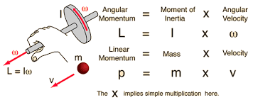
Angular Momentum
Momentum has a rotational equivalent!
Angular momentum (L)
Momentum is usually p=mv
Rotational equivalents
Also L=mvr for a point
Why is this useful?
Conservation of angular momentum!
Angular Impulse…
Torque!

Slide 9
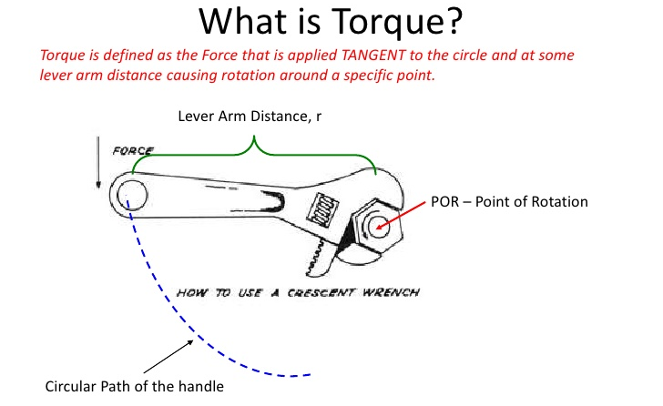
Torque
Force has a rotational equivalent!
Torque (τ)
Rotational Force
Force is usually F=ma
Rotational equivalents?
Torque is also τ=Fd=Iα
Torques cause rotation!
Units?
Rotational Impulse
Linear impulse, Ft
Rotational equivalents?

Slide 10
Practice
What is her initial angular momentum?
What will be her angular velocity after her arms are pulled in?
(I=½*m*r²)

Slide 11
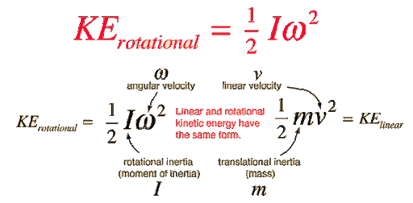
Energy
Rotational motion has energy!
Linear Kinetic energy is ½*m*v²
Rotational equivalents?
What is the rotational energy of a wheel with moment of inertia of 3 kg*m² and angular velocity of 2 rad/s?

Slide 12

Centripetal Acceleration
https://www.youtube.com/watch?v=bpFK2VCRHUs
Units?
What is the centripetal acceleration of an object with a velocity of 6 m/s rotating at a radius of 3m?
Notes:
https://www.youtube.com/watch?v=bpFK2VCRHUs

Slide 13
Review Videos
https://www.youtube.com/watch?v=fmXFWi-WfyU
https://www.youtube.com/watch?v=b-HZ1SZPaQw
Notes:
https://www.youtube.com/watch?v=fmXFWi-WfyU
https://www.youtube.com/watch?v=b-HZ1SZPaQw

